Slide 1

CS2113/T – Lecture 5
Setup before continuing the video:
Fork github.com/nus-cs2113-AY2021S2/mega-circus
Clone the fork to your machine
Set up the project in the IDE
Sanity check: run Circus.main()
Sanity check: run text-ui-tests
This lecture will be recorded
This lecture will be recorded

Slide 2

Recap
Abstract class – type hierarchy
Interfaces – behavior specification
Casting
Git Branching

Slide 3
Set up: Circus project (contd. from last week)
Add cs2113-AY2021S2/circus as upstream remote
git@github.com:nus-cs2113-AY2021S2/circus.git OR
https://github.com/nus-cs2113-AY2021S2/circus.git
Fetch -> Fetch from all remotes (which is default selected)
Checkout master
Merge upstream/master
Notice new Animals in the Circus
Notice all Animals have Names
Run Circus class
Push master to your origin
1. Add remote: git remote add upstream <link>
e.g. git remote add upstream https://github.com/nus-cs2113-AY2021S2/circus.git
2. Fetch upstream: git fetch upstream
(To fetch from multiple remotes, run this command for each remote)
3. Checkout master: git checkout master
4. Merge upstream/master: git merge upstream master

Slide 4
Jumping ahead
Briefly – Synchronizing the fork with upstream

Slide 5
Activity: New Animals
Try to add new Animals to the animals array
Sort the animals
Find where a particular animal is

Slide 6
Arrays class
Useful Java class to work with Arrays
Arrays.asList() -> returns fixed size (array) list
Arrays.toString() -> provides string representation of arrays
Arrays.copyOf() -> creates a copy of the specified elements
ArrayList<Animal> animalArrayList = new ArrayList<>(Arrays.asList(animals));

Slide 7
Collections
Collection
Map
Object that groups multiple elements into a single unit
List
Set
HashMap
ArrayList
TreeSet
Interfaces
Implementations
Algorithms

Slide 8
Resizable Array
ArrayList
ArrayList<Duck> animalArrayList = new ArrayList<>();
Duck louie = new Duck(“Louie”);
Duck huey = new Duck(“Huey”);
Duck dewey = new Duck(“Dewey”);
animalArrayList.add(louie);
animalArrayList.add(huey);
animalArrayList.add(dewey);
animalArrayList.indexOf(huey);
animalArrayList.remove(huey);

Slide 9
Key-Value pairs
HashMap
HashMap<String, Point> points = new HashMap<>(); points.put("x1", new Point(0, 0)); points.put("x2", new Point(0, 5)); points.put("x3", new Point(5, 5)); points.put("x4", new Point(5, 0));

Slide 10
Detour – RCS

Slide 11
4
fix1
3
HEAD
master
2
Merge fix1 to master
1

Slide 12
Fast-forward merge
Merge without Fast-forward
5
HEAD
master
4
fix1
4
fix1
4
3
3
3
HEAD
master
2
2
2
Merge fix1 to master
1
1
1

Slide 13
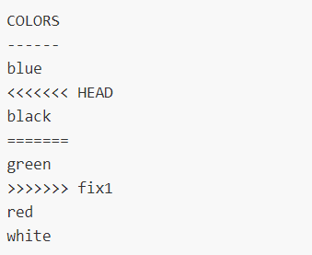
Merge conflict
Fast-forward merge
Merge without Fast-forward
5
HEAD
master
4
fix1
4
fix1
4
3
3
3
HEAD
master
2
2
2
Merge fix1 to master
1
1
1

Slide 14
Activity: Put Animals in cage
Merge upstream/generics_cage to master
Observe the usage of T in Cage class
Observe how different cages are created

Slide 15
Generics
Allow parametrization of types
Same code works on different types
Type Parameter
public class Cup<T> {
private T item;
public void set(T item) {
this.item = item;
}
public T get() {
return item;
}
}

Slide 16
Generics – used extensively in Collections
ArrayList<Duck> animalArrayList = new ArrayList<>();
HashMap<String, Point> points = new HashMap<>();

Slide 17
Activity: Packaging in a JAR

Slide 18
Requirements

Slide 19
ESTABLISHING requirements
SURVEYS
INTERVIEWS
FOCUS GROUPS
PROD. STUDY
OBSERVE
BRAINSTORM

Slide 20
SPECIFYING requirements
PROTOTYPES
PROTOTYPES
FEATURE LIST
USER STORIES
PROSE
FEATURE LIST
USER STORIES
PROSE
USE CASES
SUPPLEMENTARY
SUPPLEMENTARY
GLOSSARY

Slide 21
Pre-lecture exercise [do in pairs] : Imagine you are building an online system called TeamFormer. Specify the vision, scope, user types, and the workflow of TeamFormer. Specify requirements of TeamFormer as a list of User Stories.
TeamFormer is a system for helping CS2113 students during team forming period. It lets students record who is in which team. Students can use the system to find teams short of members and students looking for teams, easing the team forming process. Note that the system is not meant as a platform for students to communicate with each other to find team members. Students are supposed to talk to each other and form teams outside the system, as they do now. TeamFormer simply helps students to see the team forming status of the class (e.g., who has teams and who doesn’t) and record their own team after forming a team. It is also meant to ease the team-forming-related workload of instructors.
Vision:
Scope: for CS2113? for NUS? for any school? for the world?
for capturing team forming status ? to form teams using system?
Users: instructor, student,
Workflow:
(a) Any student can create/join/leave any team?
(b) Instructor creates slots and leader sign up for slots?
To make team forming easier
admin?, team?

Slide 22
User stories:?
As a _______
I can _______
So that_______
user
login
I can access actions available to me
logout
only my actions are identified as mine
instructor
specify a team forming period
Team forming happens in a limited period
specify which students take part
Only the relevant students take part
student without a team
see others looking for teammates
I know who are potential team members
specify my profile
others know the value they get if they take me as a team member

Slide 23
User stories:?
As a _______
I can _______
So that_______
user
login
I can access actions available to me
logout
only my actions are identified as mine
instructor
specify a team forming period
Team forming happens in a limited period
specify which students take part
Only the relevant students take part
student without a team
see others looking for teammates
I know who are potential team members
specify my profile
others know the value they get if they take me as a team member

Slide 24

User stories:?
As a _______
I can _______
So that_______
user
login
I can access actions available to me
logout
only my actions are identified as mine
instructor
specify a team forming period
Team forming happens in a limited period
specify which students take part
Only the relevant students take part
student without a team
see others looking for teammates
I know who are potential team members
specify my profile
others know the value they get if they take me as a team member

Slide 25
User stories:?
As a _______
I can _______
So that_______
student without a team
see others looking for teammates
I know who are potential team members
specify my profile
others know the value they get if they take me as a team member
representative of a team
register the team
others know we have a team
rep of a partial team
specify count and nature of vacancies
others matching the vacancies can approach
rep of a team
remove a member
others know he/she is no longer with the team
student in a team
remove self from the team
others know that I am no longer with that team
And more…

Slide 26
Use case: add student to team
Actor: Instructor
Pre-condition: Logged in
MSS:
1. Instructor chooses student to add
2. System shows teams that can take the student
3. Instructor indicates which team to add
4. System applies the change and updates the view
Use case ends
Extensions
2a Instructor chooses to add student to a new team
2a.1 System request for new team id
2a.2 Instructor provide a new team id
Use case resumes at step 4.
?a Instructor chooses to undo
?a.1 System undo the change and updates view
Use case ends.
Interactions between user and system for a specific functionality

Slide 27
Use case: add student to team
Actor: Instructor
Pre-condition: Logged in
MSS:
1. Instructor chooses student to add
2. System shows teams that can take the student
3. Instructor indicates which team to add
4. System applies the change and updates the view
Use case ends
Extensions
2a Instructor chooses to add student to a new team
2a.1 System request for new team id
2a.2 Instructor provide a new team id
Use case resumes at step 4.
?a Instructor chooses to undo
?a.1 System undo the change and updates view
Use case ends.
Captures interactions, not UI design
4
4

Slide 28
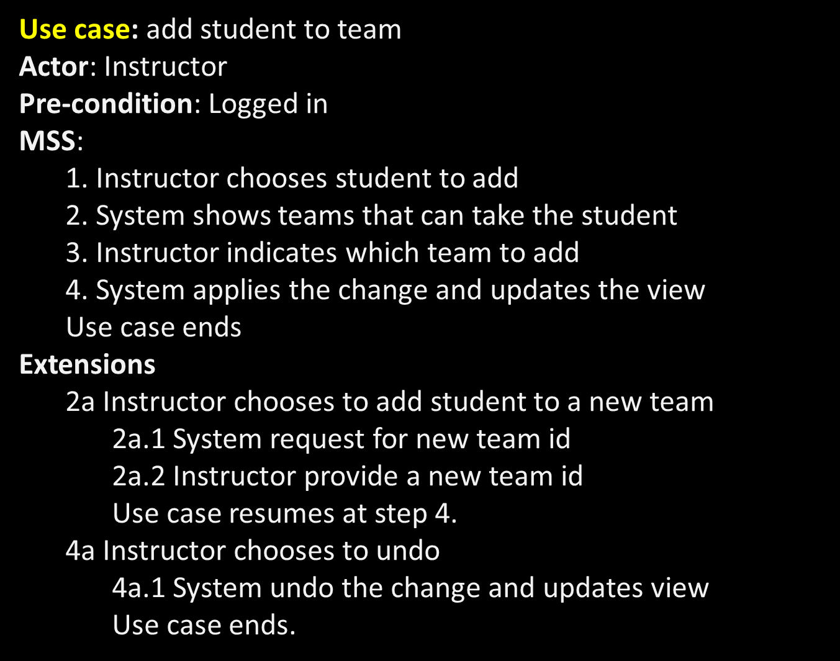

Slide 29


Slide 30

move
New team ID:
to Team 1
to Team 2
to Team 3
to a new Team
out of this Team
Team 4
save
cancel
UI prototype:?
Team 1
move
move
move
Team 2
move
move
move
Team 3
move
move
Students without teams
move
move
move
Student Jake moved to Team 1 [undo]

Slide 31
move
Glossary
TFS: team forming session
team (not group)
Loner: student without a team
Supplementary
Authentication done by Luminus.
The session is linked to Luminus module.
Only one session at a time.
Only one instructor.
No messaging, notifications done via the system.
No max/min team size.
All student actions are logged.
to Team 1
to Team 2
to Team 3
to a new Team
out of this Team
New team ID:
Team 4
save
cancel
UI prototype:?
Team 1
move
move
move
Team 2
move
move
move
Team 3
move
move
Students without teams
move
move
move
Student Jake moved to Team 1 [undo]

Slide 32
Code quality
Avoid: Empty catch blocks
public void countUntilMax() {
try {
while (true) {
increaseCount();
}
} catch (MaximumCountReachedException ex) {
}
//Continue execution
}

Slide 33
Code quality
Avoid: Recycling variables & formal parameters
public int computeArea(int length, int width) {
length = length * width;
return length;
}

Slide 34
Code quality
Minimize: variable scope; avoid globals as much as possible
Minimize: code duplication

